Slide 1
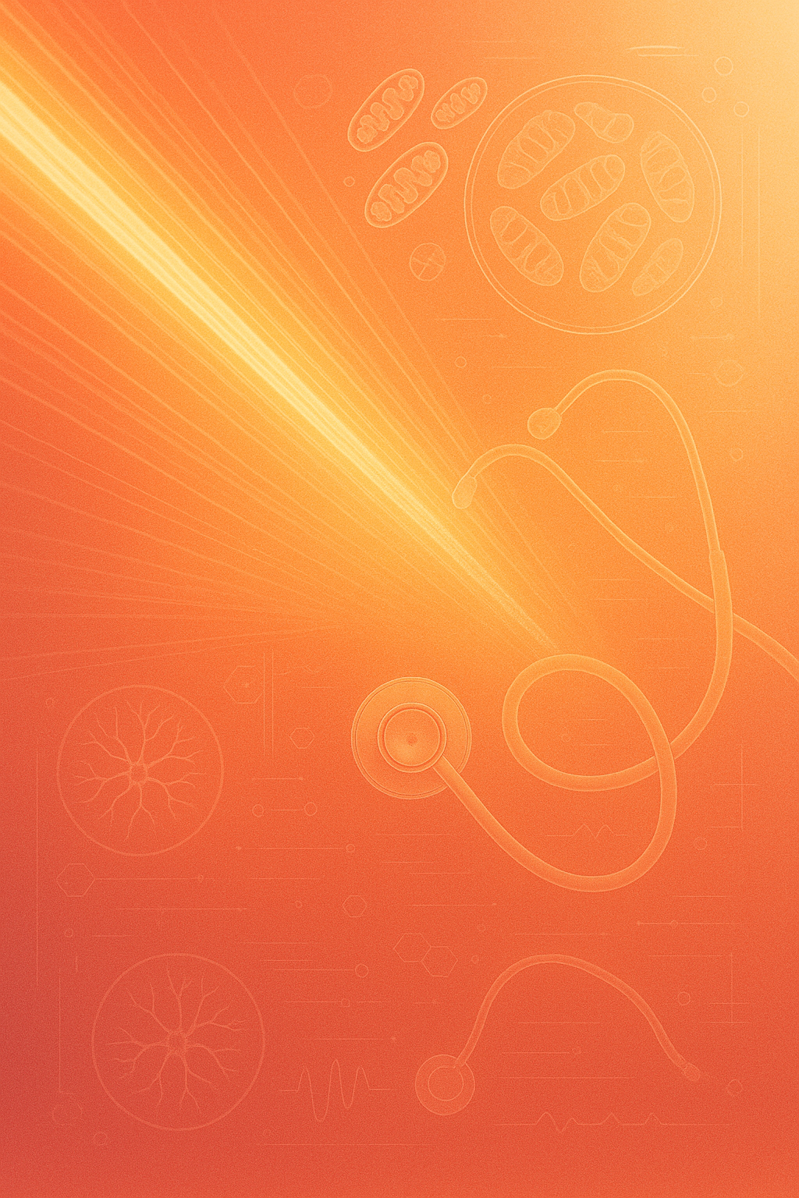
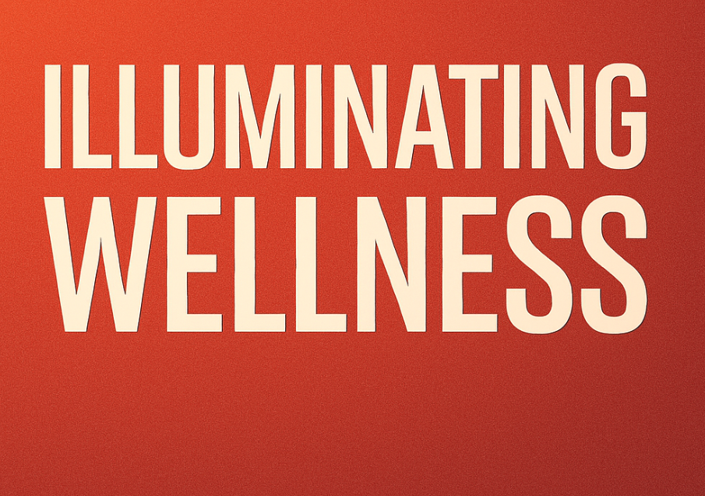
The Science of Red Light Therapy and Retinal Imaging

Slide 2
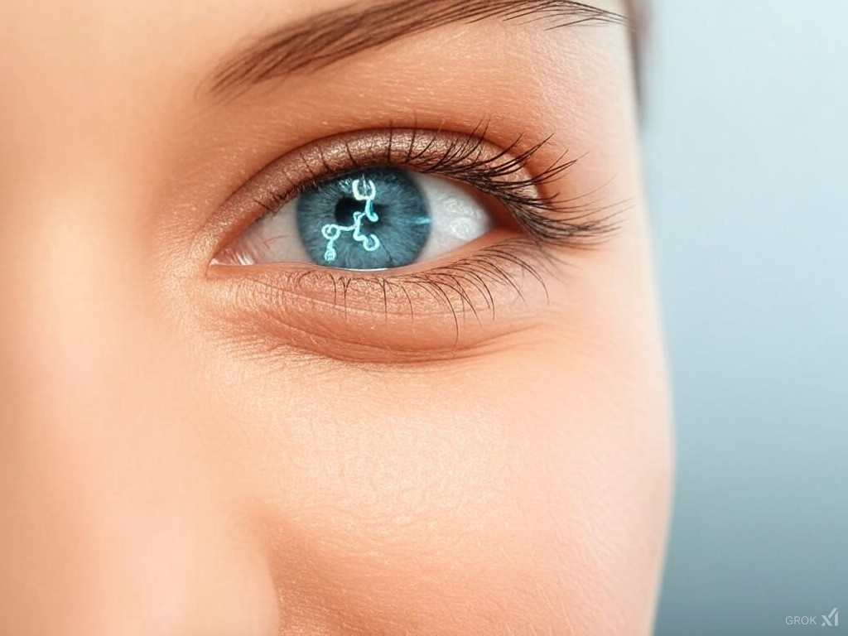
2D Opticare AI
The Red Light Miracle

